Slide 1
Skyscraper Wars
The Race to Build the Tallest Building
New York City ~ 1930’s
Providing work and opportunity
during The Great Depression!

Slide 2
The Great Depression
Stock Market Crashes ~ 1929
Unemployment, Poverty, and Homelessness spreads across the country!

Slide 3
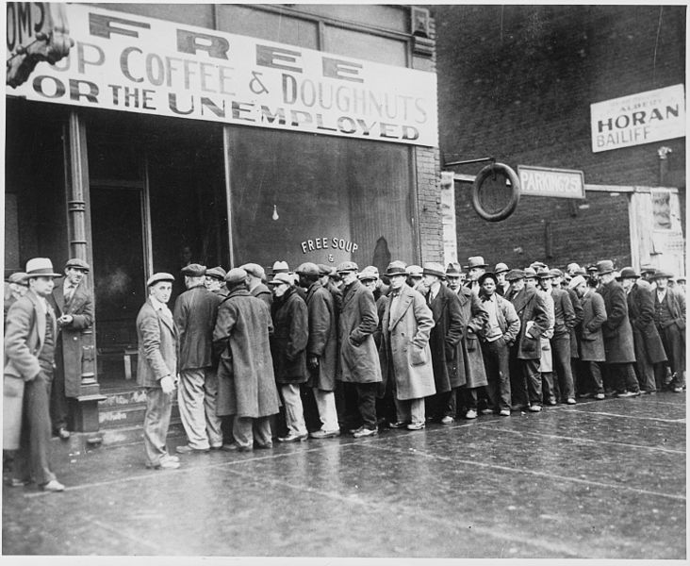
Unemployment

Slide 4
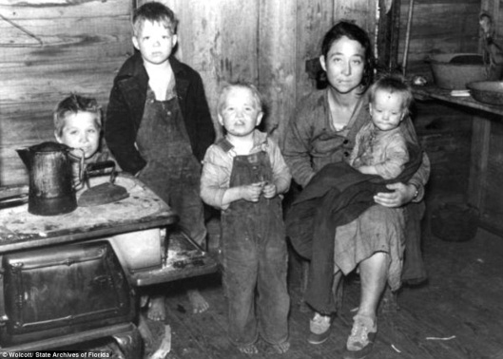
Poverty

Slide 5
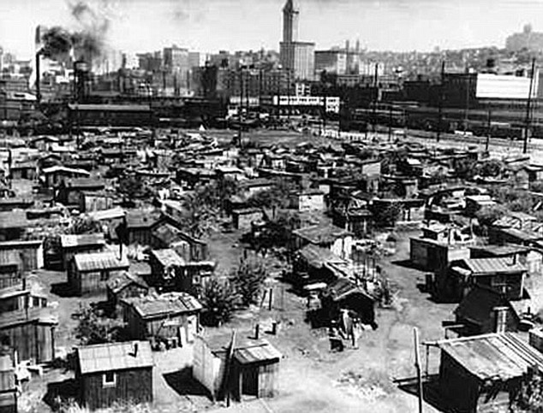
Homelessness

Slide 6
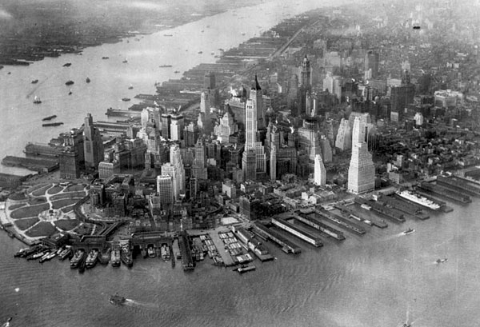
New York City
Skyline
1929
http://video.answers.com/explore-the-history-behind-the-chrysler-building-517229538
Chrysler Building Tallest Building in the World 1930 -1931 and Manhattan Trust Building Tallest Building in the world 1930 (Trump Bldg.)
http://www.history.com/videos/empire-state-building-defies-depression#empire-state-building-defies-depression
Empire State Building Tallest building in the world 1931-1970

Slide 7
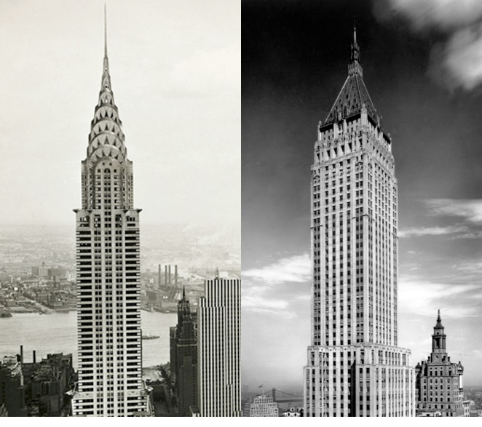

Slide 8
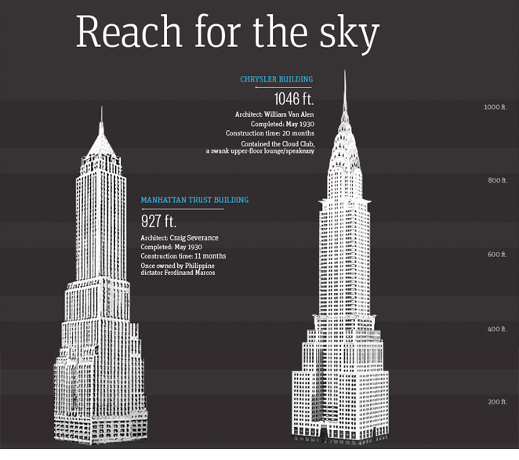

Slide 9
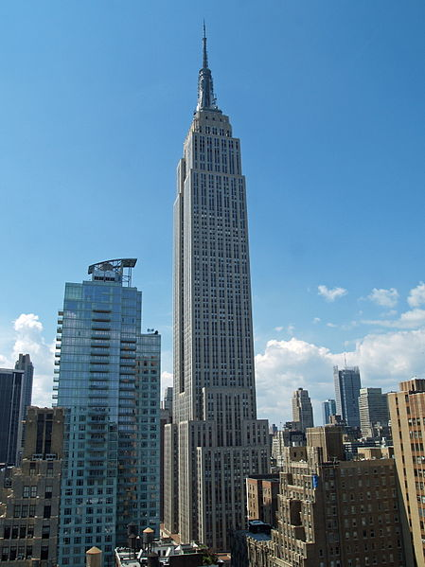

Slide 10
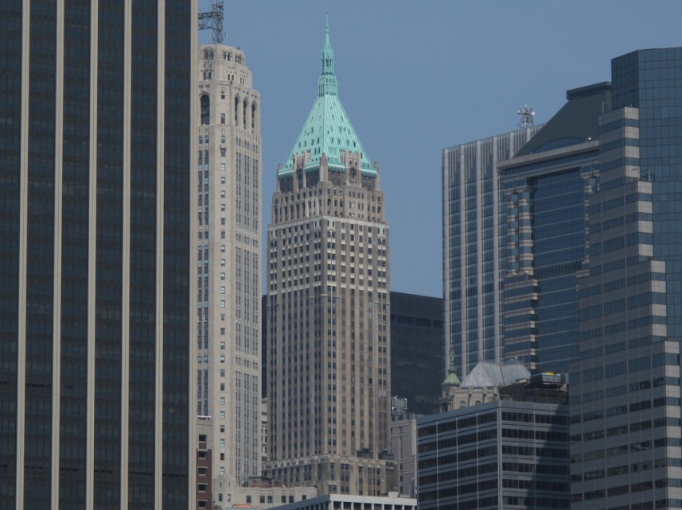
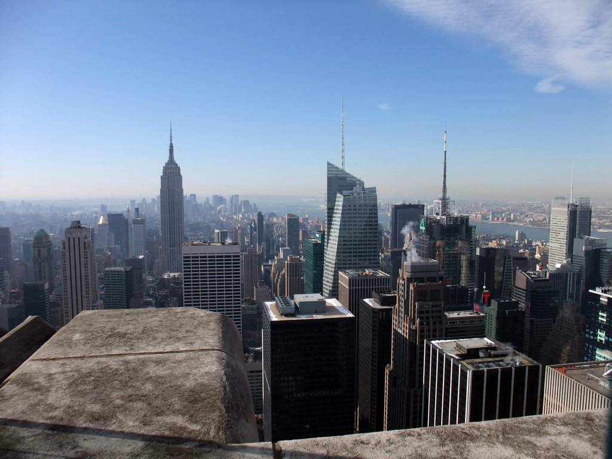
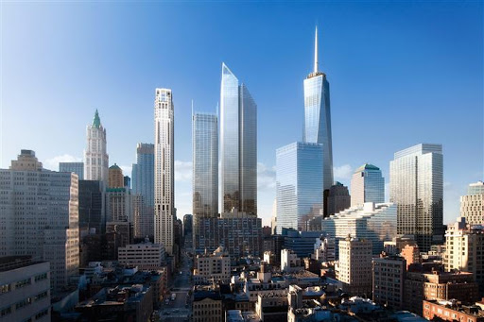
Bank of Manhattan Trust now…

Slide 11
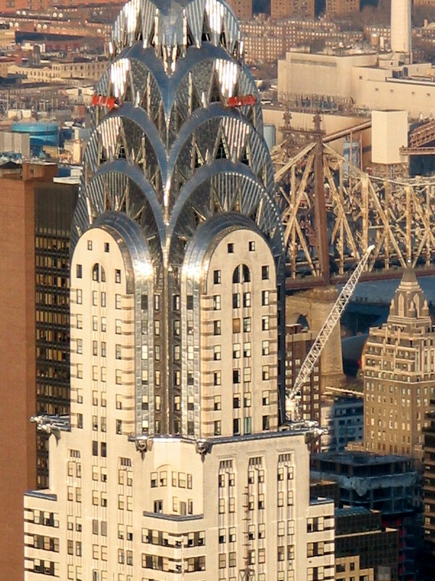
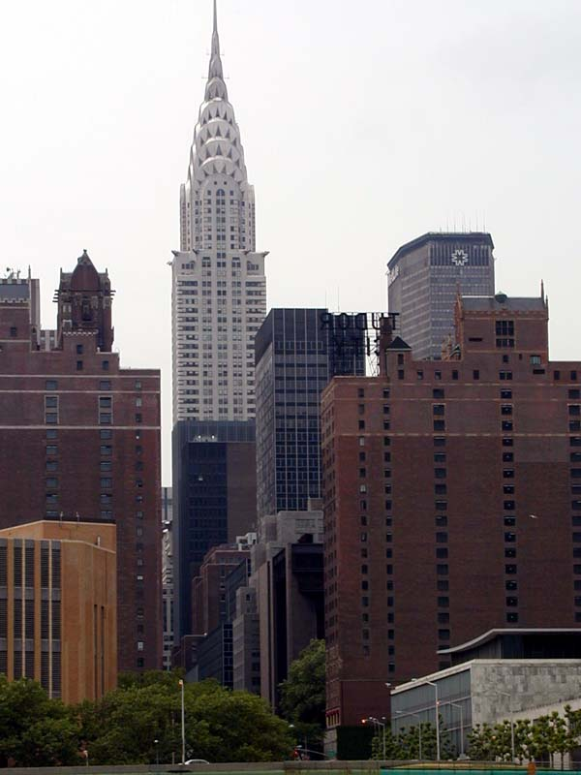
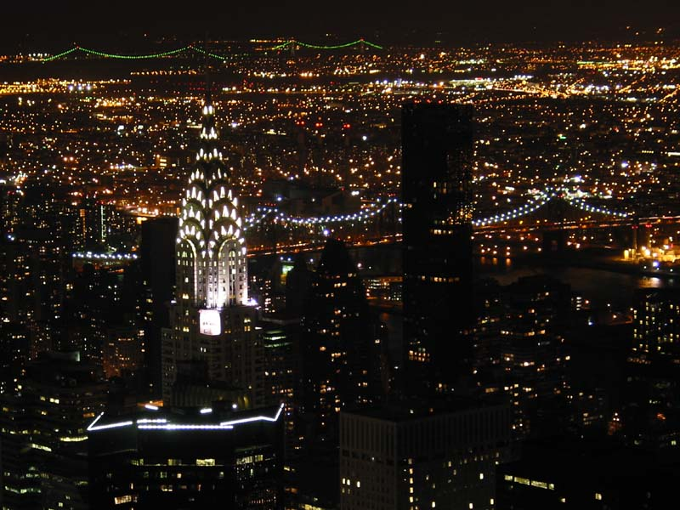
Chrysler Building now…

Slide 12
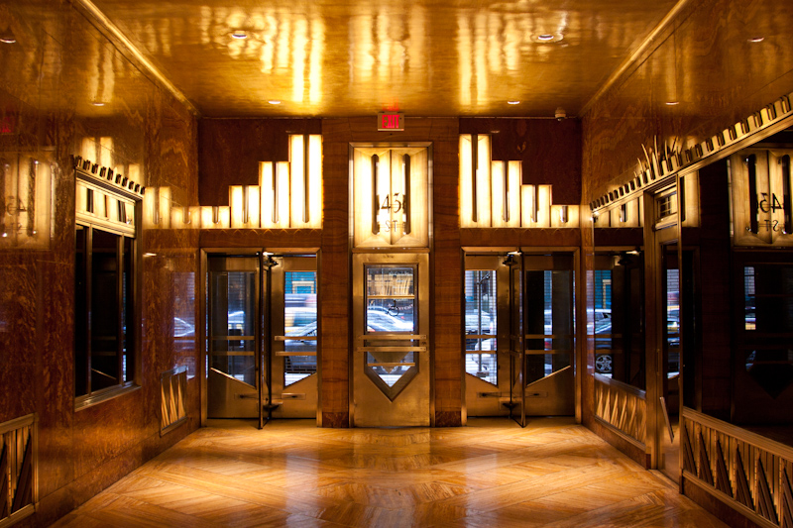
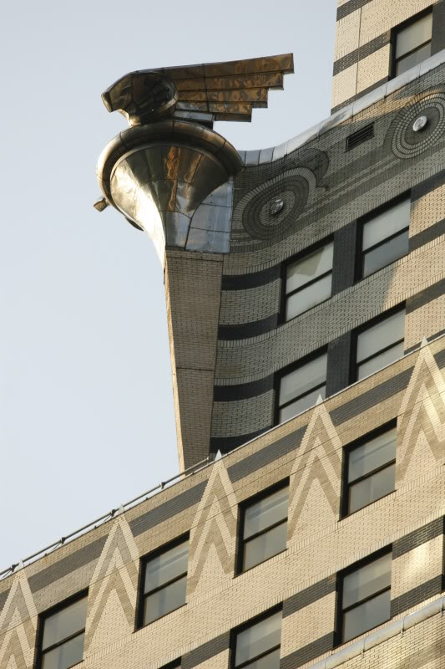
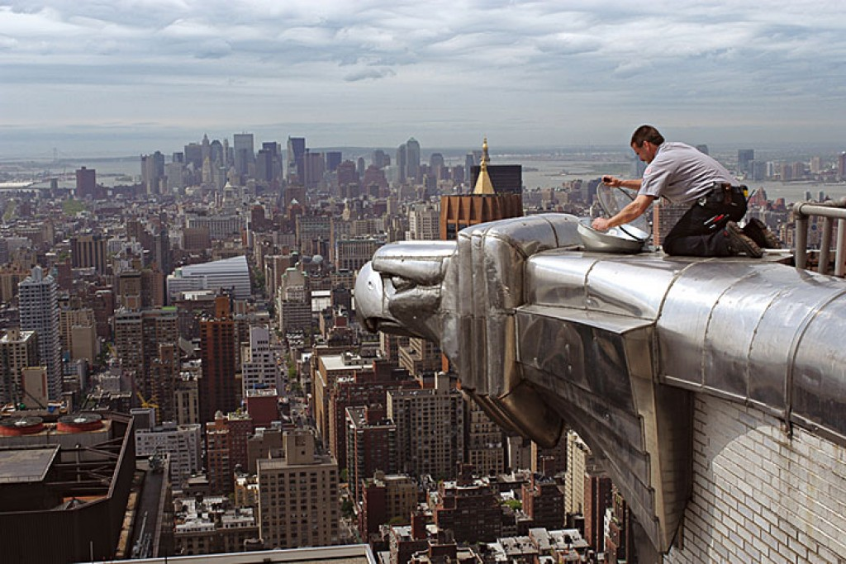
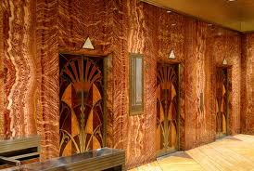

Slide 13
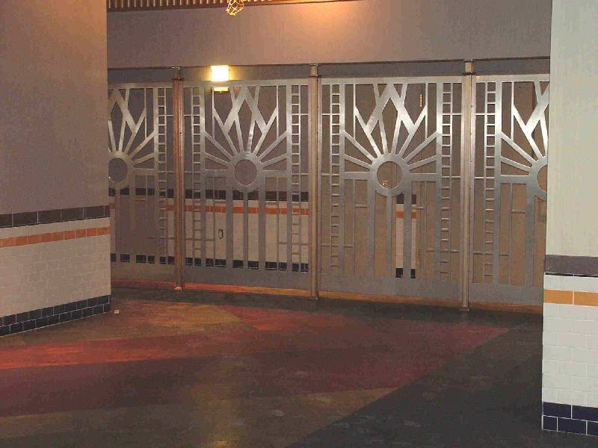
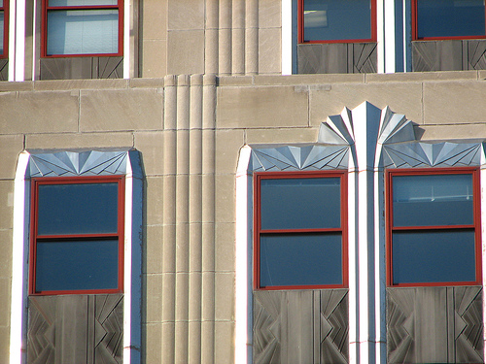
The Empire State Building now…

Slide 14
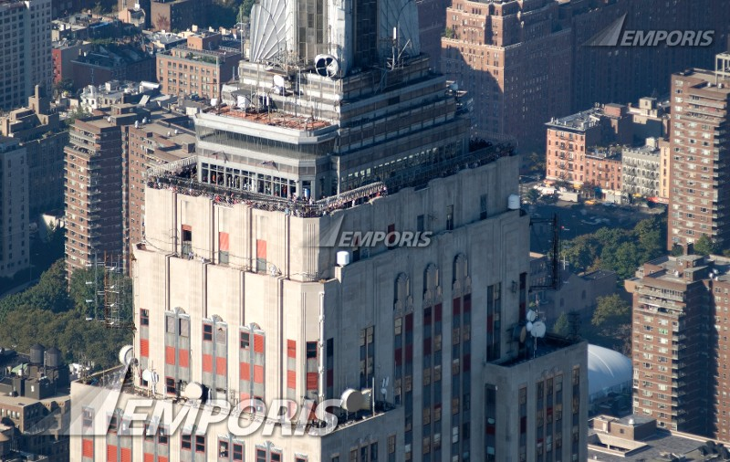
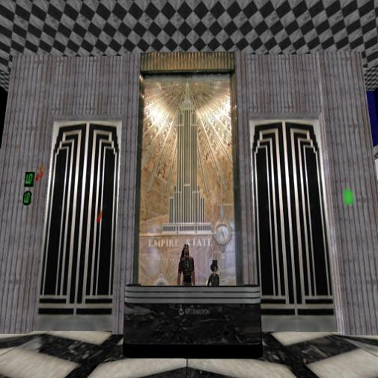
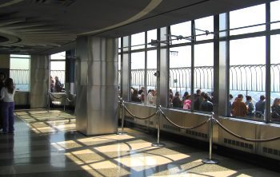
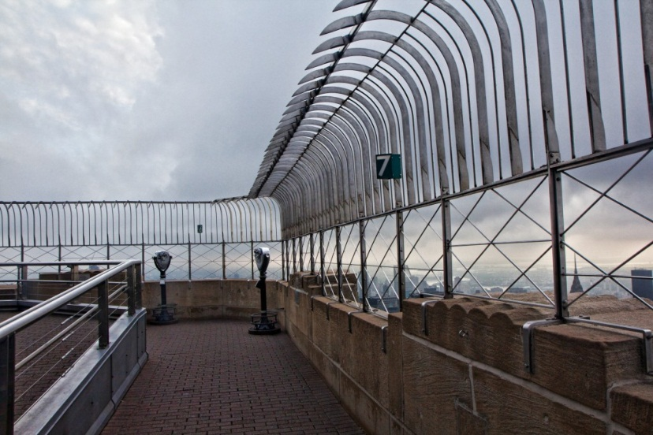

Slide 15
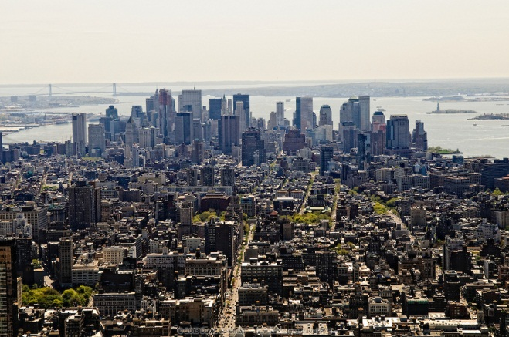
View of the City from Empire State Building Observation Deck

Slide 16
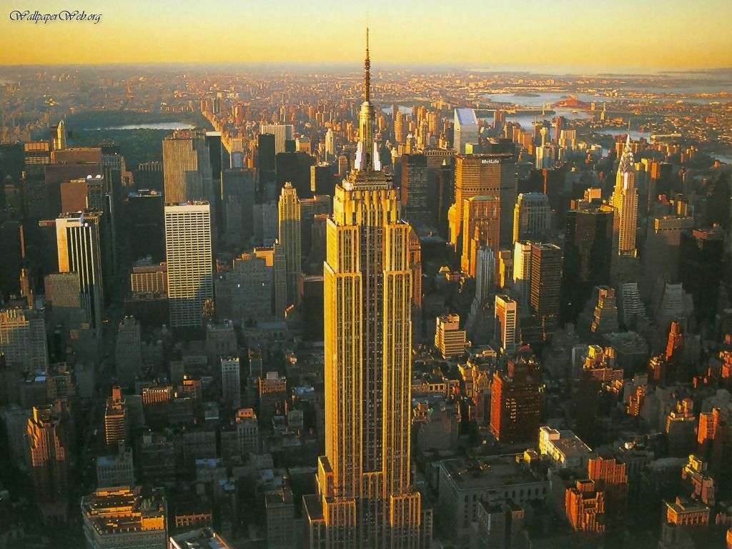
Empire State Building remained the Tallest Building in the World until 1970

